Slide 1
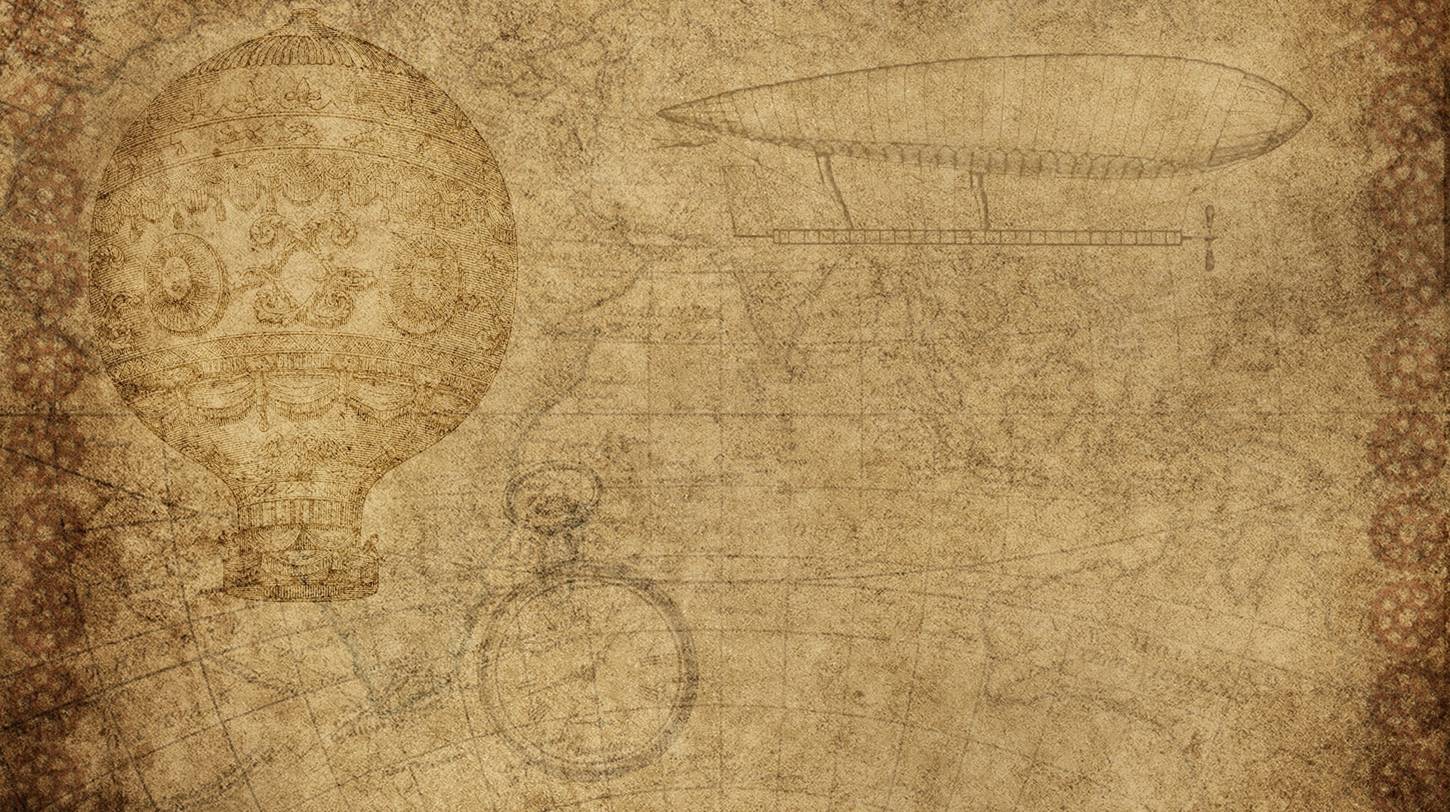

Physics Destroyer
Matthew Peace
Dustin Bramos
Steve Catherman
Steven Jazrawi
Chris Wiegand

Slide 2

Application Goal
Our goal is to create a physics calculator that will allow users to enter known variables and automatically solve all equations possible with those known variables.

Slide 3
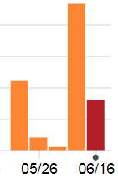
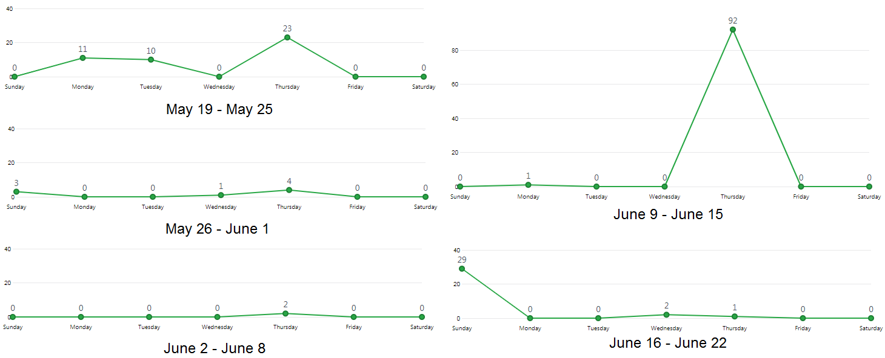
GitHub Commits

Slide 4
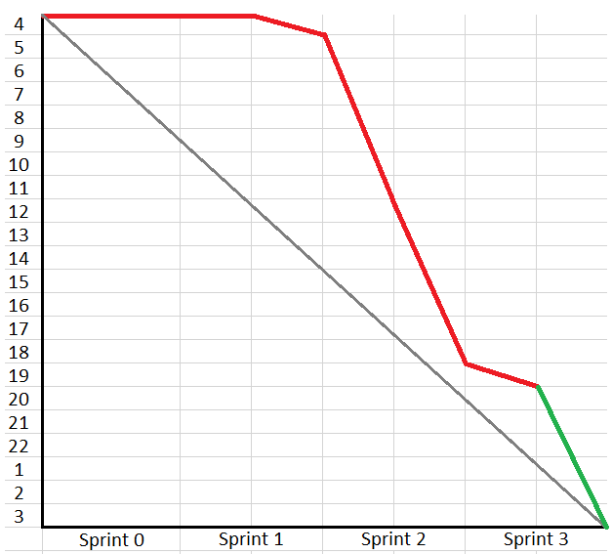

Burn Down
We were never actually this far behind, but we kept adding tasks, as we thought of new features or improvements, essentially moving the goal posts.

Slide 5

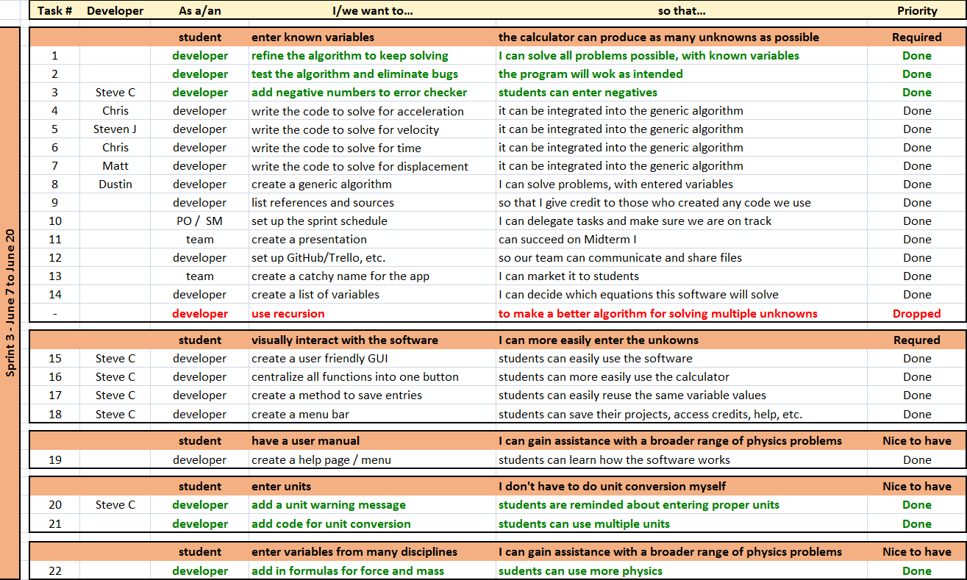
Product Backlog

Slide 6
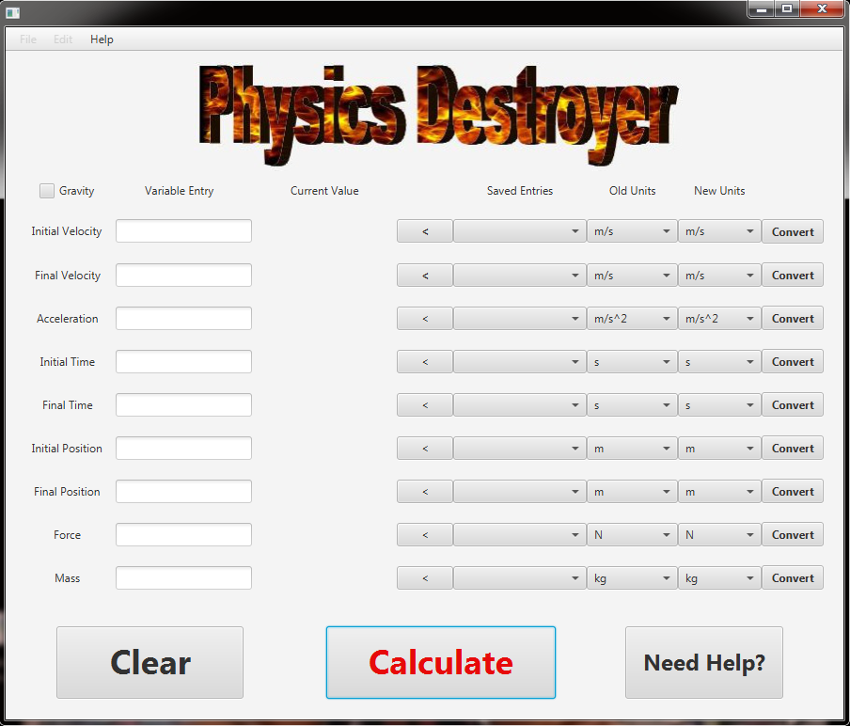
Final Look
Features:
Solves multiple equations
Saves old entries
Converts units
Error checks entries

Slide 7
Final Thoughts / Future Improvements
Add more formulas, to expand into other areas of physics
Add more extensive unit conversion feature
Add ability to save old calculator sessions
Create web page / app for mobile use

